Slide 1

Social Engineering

Slide 2

What is Social Engineering?
Manipulation
Seeking password, banking information, and/or access
Taking advantage of your trust

Slide 3
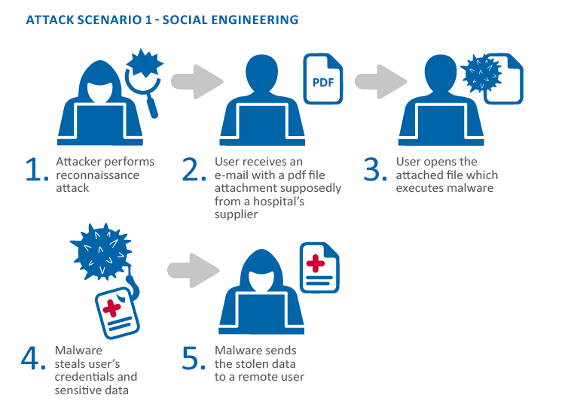
What does Social Engineering look like?
Baiting Scenarios
Free Downloads
USB Drop Attack
Pretexting
Tailgating / Piggybacking

Slide 4

How to protect yourself
Slow Down
Don’t blindly follow links
Be careful of downloads
Delete any request for financial information or passwords

Slide 5
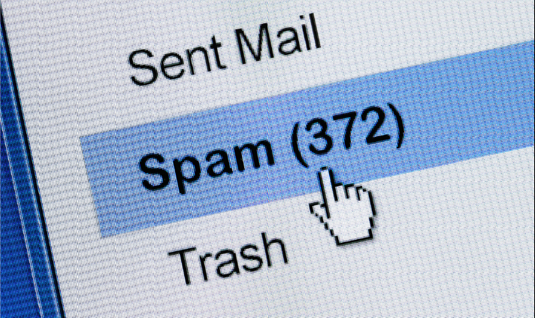
How to protect yourself cont.
Reject offers of help unless you asked
Set spam filters to high
Secure your devices
Be careful of robocallers
Be aware

